Slide 1
Introduction to Association Analysis

Slide 2
Association Analysis/Association Rule Mining
Process of identifying and extracting association between attribute value conditions that frequently occur together in the given dataset.
Represented in terms of association rules
An association rule is of the form,
X⇒Y where X & Y are attribute value conditions such that X∩Y=Φ
Interpretation: Those database tuples that satisfy attribute value condition in X likely to satisfy condition in Y
For example, following rules from customer database,
Buys (C, “computer”) ⇒ Buys (C, “software”)
Income(C, “50K..80K”) ∧ Age(C, “30..40”) ⇒
Buys(C, “home appliance”)

Slide 3
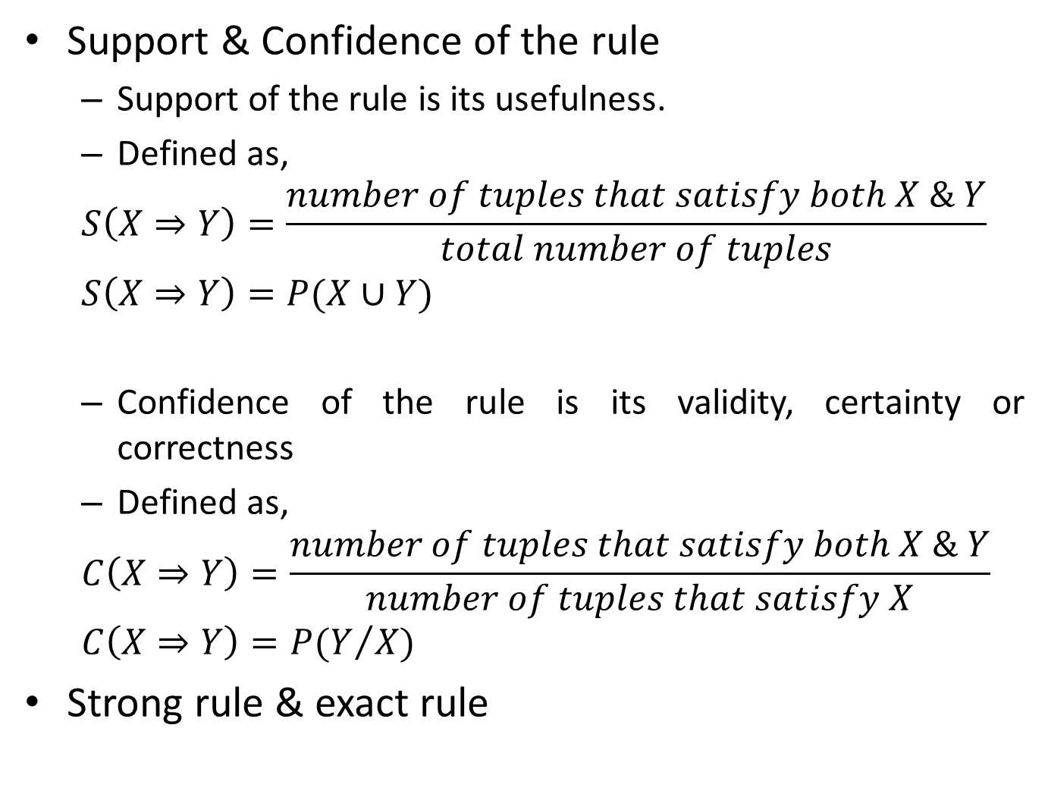
Support & Confidence of the rule
Support of the rule is its usefulness.
Defined as,
$$S\left(X⇒Y\right)=\frac{number of tuples that satisfy both X \& Y}{total number of tuples}$$
$$S\left(X⇒Y\right)=P(X∪Y)$$
Confidence of the rule is its validity, certainty or correctness
Defined as,
$$C\left(X⇒Y\right)=\frac{number of tuples that satisfy both X \& Y}{number of tuples that satisfy X}$$
$$C\left(X⇒Y\right)=P(Y/X)$$
Strong rule & exact rule

Slide 4
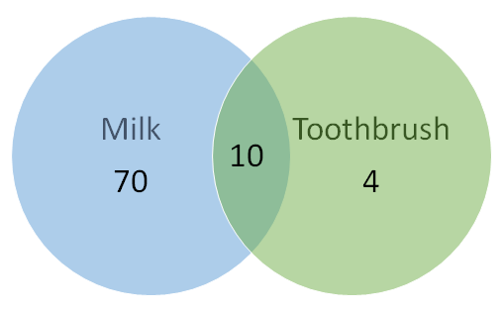
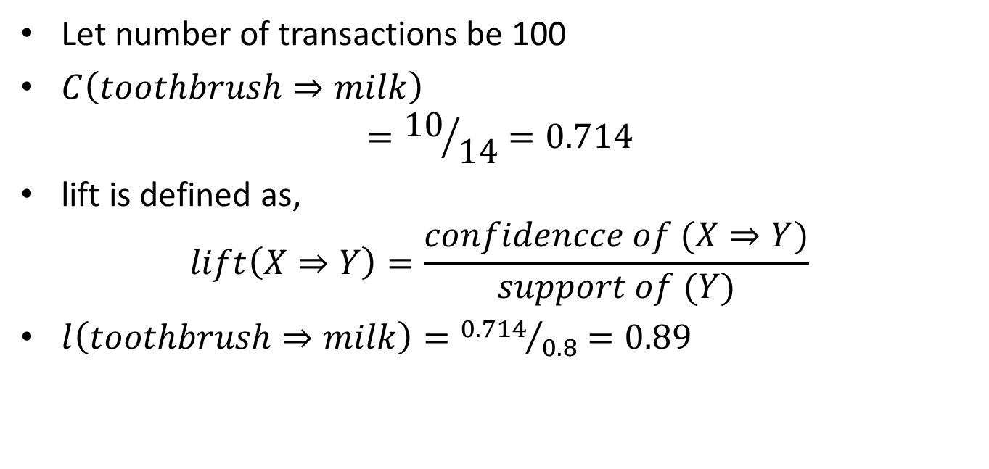
Let number of transactions be 100
$C\left(toothbrush⇒milk\right)$
$$={10}/{14}=0.714$$
lift is defined as,
$$lift\left(X⇒Y\right)=\frac{confidencce of (X⇒Y)}{support of (Y)}$$
$l\left(toothbrush⇒milk\right)={0.714}/{0.8}=0.89$

Slide 5
Types of association rules
Based on type of value
Boolean rules deal with absence & presence of values
Buys (C, “computer”) ⇒ Buys (C, “software”)
Quantitative rules deal with range of values
Income(C, “50K..80K”) ∧ Age(C, “30..40”) ⇒
Buys(C, “home appliance”)
Based on number of attributes
Single dimensional
Multi-dimensional
Based on level of abstraction
Single level
Multi-level
Buys (C, “HP laptop”) ⇒ Buys (C, “MATLAB”)

Slide 6
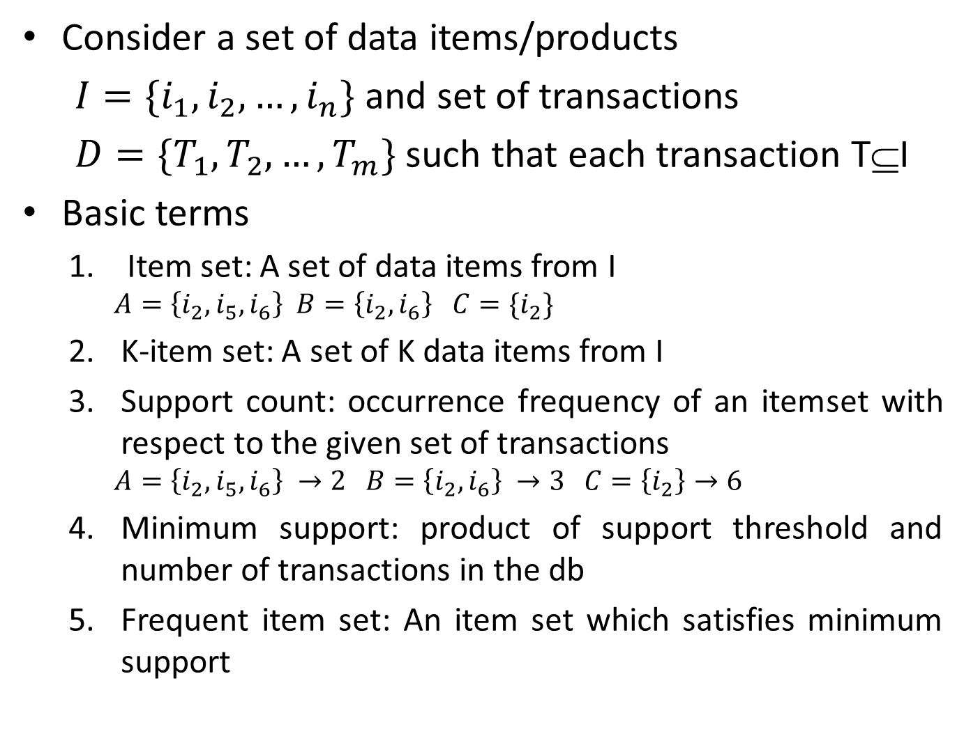
Consider a set of data items/products
$I=\{i_{1},i_{2},…,i_{n}\}$ and set of transactions
$D=\{T_{1},T_{2},…,T_{m}\}$ such that each transaction T⊆I
Basic terms
Item set: A set of data items from I
$$A=\left\{i_{2},i_{5},i_{6}\right\} B=\left\{i_{2},i_{6}\right\} C=\{i_{2}\}$$
K-item set: A set of K data items from I
Support count: occurrence frequency of an itemset with respect to the given set of transactions
$$A=\left\{i_{2},i_{5},i_{6}\right\} →2 B=\left\{i_{2},i_{6}\right\} →3 C=\left\{i_{2}\right\}→6$$
Minimum support: product of support threshold and number of transactions in the db
Frequent item set: An item set which satisfies minimum support

Slide 7
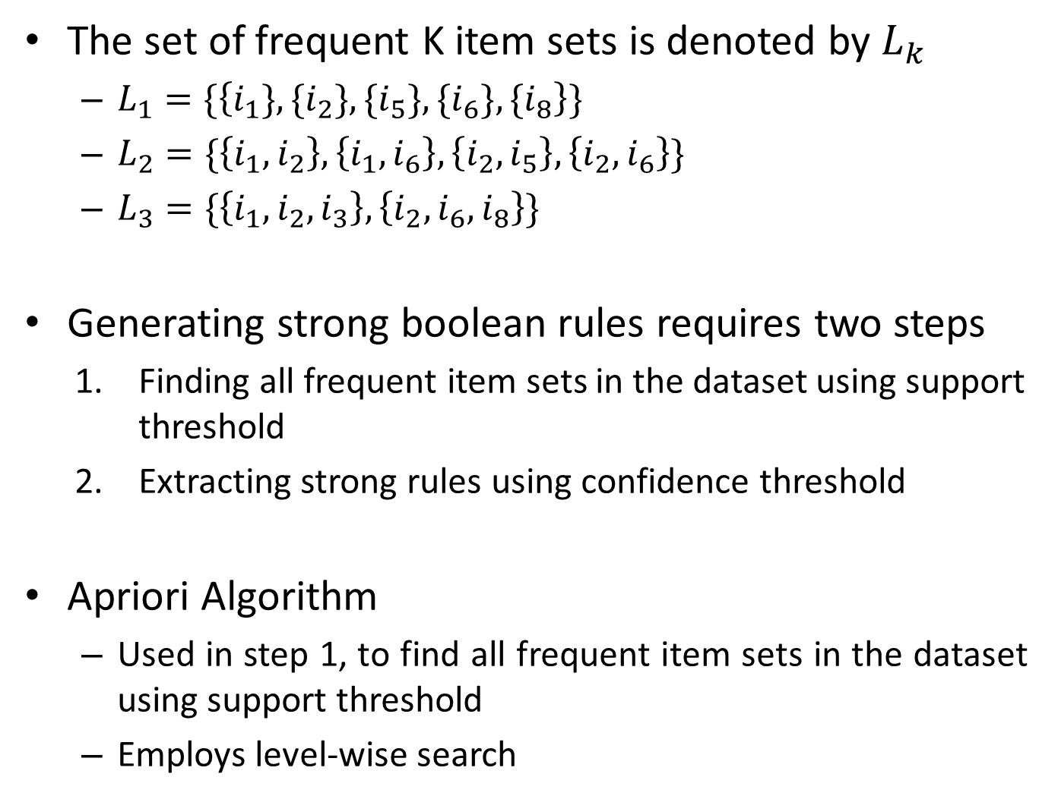
The set of frequent K item sets is denoted by $L_{k}$
$L_{1}=\{\left\{i_{1}\},{\{i}_{2}\},{\{i}_{5}\},{\{i}_{6}\},{\{i}_{8}\right\}\}$
$L_{2}=\{\left\{i_{1},i_{2}\right\},\left\{i_{1},i_{6}\right\},\left\{i_{2},i_{5}\right\},\left\{i_{2},i_{6}\right\}\}$
$L_{3}=\{\left\{i_{1},i_{2},i_{3}\right\},\left\{i_{2},i_{6},i_{8}\right\}\}$
Generating strong boolean rules requires two steps
Finding all frequent item sets in the dataset using support threshold
Extracting strong rules using confidence threshold
Apriori Algorithm
Used in step 1, to find all frequent item sets in the dataset using support threshold
Employs level-wise search

Slide 8
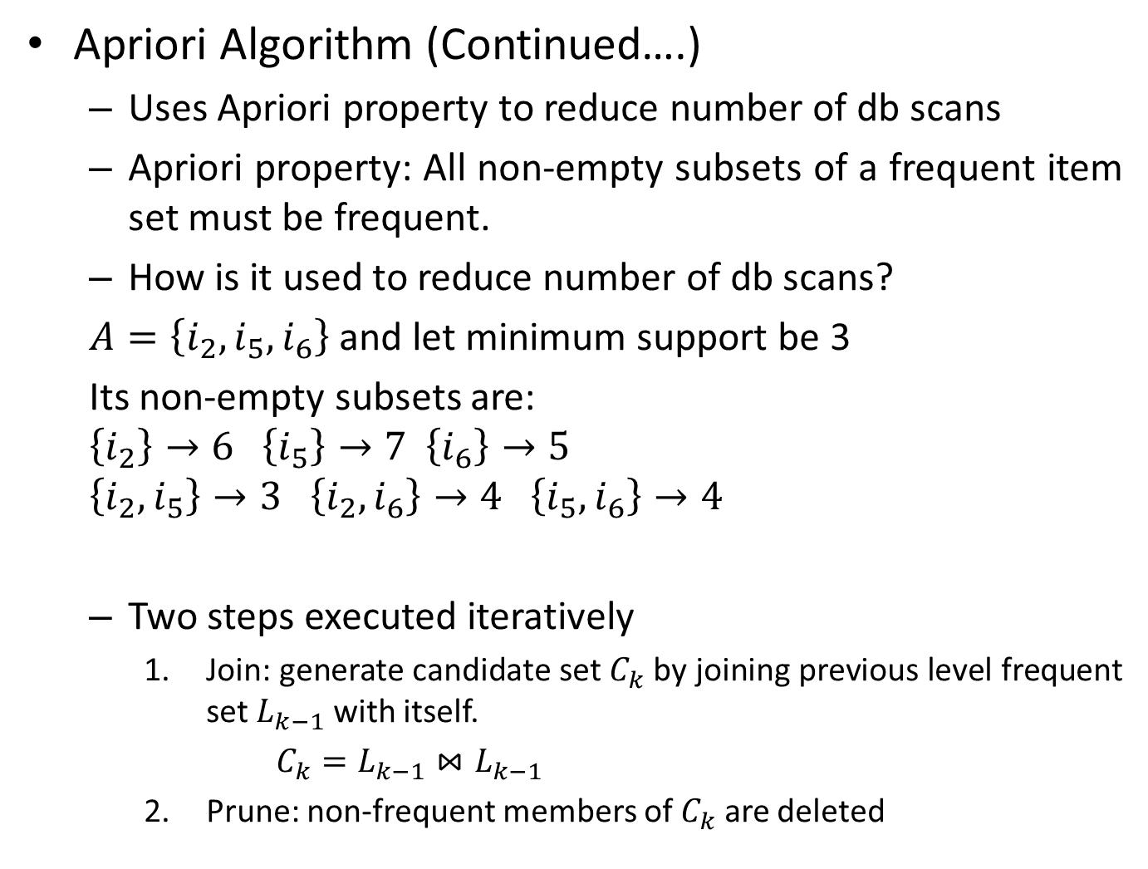
Apriori Algorithm (Continued….)
Uses Apriori property to reduce number of db scans
Apriori property: All non-empty subsets of a frequent item set must be frequent.
How is it used to reduce number of db scans?
$A=\left\{i_{2},i_{5},i_{6}\right\}$ and let minimum support be 3
Its non-empty subsets are:
$$\left\{i_{2}\right\}→6 \left\{i_{5}\right\}→7 \left\{i_{6}\right\}→5$$
$$\left\{i_{2},i_{5}\right\}→3 \left\{i_{2},i_{6}\right\}→4 \left\{i_{5},i_{6}\right\}→4$$
Two steps executed iteratively
Join: generate candidate set $C_{k}$ by joining previous level frequent set $L_{k−1}$ with itself.
$C_{k}=L_{k−1}⋈L_{k−1}$
Prune: non-frequent members of $C_{k}$ are deleted

Slide 9
Transaction | List of items
T1 | I1,I2,I3
T2 | I2,I3,I4
T3 | I4,I5
T4 | I1,I2,I4
T5 | I1,I2,I3,I5
T6 | I1,I2,I3,I4
Item | Count
I1 | 4
I2 | 5
I3 | 4
I4 | 4
I5 | 2
Item | Count
I1 | 4
I2 | 5
I3 | 4
I4 | 4
Item | Count
I1,I2 | 4
I1,I3 | 3
I1,I4 | 2
I2,I3 | 4
I2,I4 | 3
I3,I4 | 2
L1
Support threshold=50% => 0.5*6= 3 => min_sup=3
L2
Item | Count
I1,I2 | 4
I1,I3 | 3
I2,I3 | 4
I2,I4 | 3
Item | Count
I1,I2,I3 | 3
I2,I3,I4 | Discarded with apriori
Item | Count
I1,I2,I3 | 3
L3

Slide 10
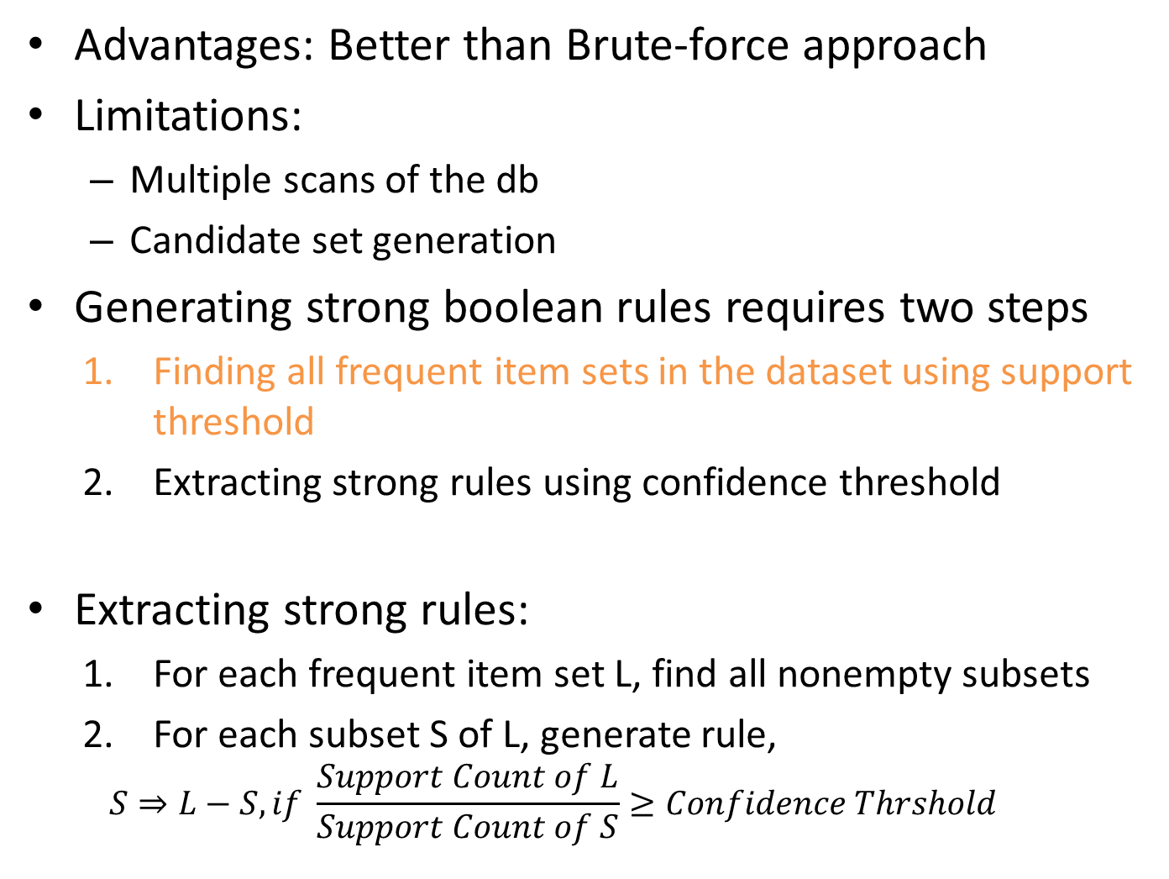
Advantages: Better than Brute-force approach
Limitations:
Multiple scans of the db
Candidate set generation
Generating strong boolean rules requires two steps
Finding all frequent item sets in the dataset using support threshold
Extracting strong rules using confidence threshold
Extracting strong rules:
For each frequent item set L, find all nonempty subsets
For each subset S of L, generate rule,
$$S⇒L−S, if \frac{Support Count of L}{Support Count of S}≥Confidence Thrshold$$

Slide 11
Let Confidence Threshold = 75%
L= {i1, i2, i3}
The process is repeated for all frequent item sets
Subset S | L-S | Rule | Confidence | Lift | Rejected/Selected
i1 | i2,i3 | i1=>i2,i3 | 3/4=75% |  | Selected
i2 | i1,i3 | i2=>i1,i3 | 3/5= 60% |  | Rejected
i3 | i1,i2 | i3=>i1,i2 | 3/4=75% |  | Selected
i1,i2 | i3 | i1,i2=>i3 | 3/4=75% |  | Selected
i1,i3 | i2 | i1,i3=>i2 | 3/3=100% |  | Selected
i2,i3 | i1 | i2,i3=>i1 | 3/4=75% |  | Selected

Slide 12
FP (Frequent Pattern) Growth
Generates frequent item sets without generating candidate sets.
Uses FP tree to map transactional db into tree such that association information is retained
Transaction | List of items
T1 | I1,I2,I3
T2 | I2,I3,I4
T3 | I4,I5
T4 | I1,I2,I4
T5 | I1,I2,I3,I5
T6 | I1,I2,I3,I4
Item | Count
I1 | 4
I2 | 5
I3 | 4
I4 | 4
I5 | 2
Item | Count
I2 | 5
I1 | 4
I3 | 4
I4 | 4
Arrange frequent items in descending order
Find support count of each item
Support threshold=50% => 0.5*6= 3 => min_sup=3

Slide 13
Transaction | List of items
T1 | I1,I2,I3
T2 | I2,I3,I4
T3 | I4,I5
T4 | I1,I2,I4
T5 | I1,I2,I3,I5
T6 | I1,I2,I3,I4
Null
Null
i2:1
i2:2
i1:1
i1:1
i3:1
i3:1
i3:1
i4:1
After T1
After T2
Order is i2, i1, i3, i4
Null
Null
Null
Null
i2:5
i4:1
i2:2
i4:1
i2:3
i4:1
i2:4
i4:1
i1:4
i3:1
i1:1
i3:1
i1:2
i3:1
i1:3
i3:1
i3:3
i4:1
i4:1
i3:1
i4:1
i3:1
i4:1
i4:1
i3:2
i4:1
i4:1
i4:1
After T3
After T4
After T5
After T6

Slide 14
Null
Item | SC | Ptr
I4 | 4
I3 | 4
I1 | 4
I2 | 5
i2:5
i4:1
Item | Conditional Pattern Base
I4 | {i2,i1,i3:1}, {i2,i1:1}, {i2,i3:1}
I3 | {i2,i1:3}, {i2:1}
I1 | {i2:4}
I2 | Null
i1:4
i3:1
i3:3
i4:1
i4:1
i4:1
Item | FP generated
I4 | {i2,i4:3}
I3 | {i2,i3:4}, {i1,i3:3}, {i2,i1,i3:3}
I1 | {i2,i1:4}
I2 | Null
Item | Conditional FP Tree
I4 | {i2:3}
I3 | {i2:4}, {i1:3}, {i2,i1:3}
I1 | {i2:4}
I2 | Null

